Slide 1


Evaluating surface ozone-temperature relationships over the eastern U.S. in chemistry-climate models
D.J. Rasmussen, Arlene Fiore, Vaishali Naik, Larry Horowitz (GFDL/NOAA), Sean McGinnis (Princeton), and Martin Schultz (Forschungszentrum Jülich)
Fall Meeting of the American Geophysical Union
December 5th, 2011
Notes:
...going to be talking about surface O3-t relationships and how we can use them to evaluate chemistry climate models
Acknowledge co-authors

Slide 2
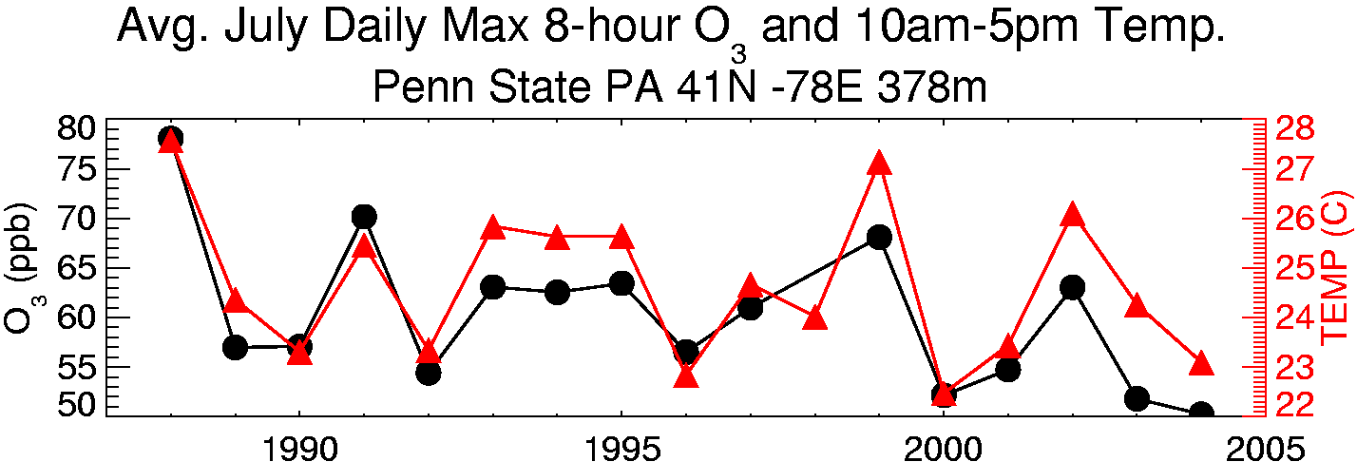
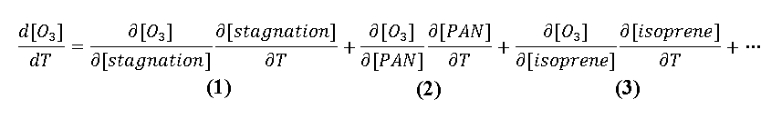
Surface O₃ varies strongly with temperature
Observational studies have shown strong correlation between surface temperature and O₃ concentrations (Bloomer et al., 2009; Camalier et al., 2007; Cardelino and Chameides, 1990; Korsog and Wolff, 1991; Clark and Karl, 1982)
Observations U.S. EPA CASTNet
c/o A.M. Fiore
The O₃-temperature relationship is thought to represent at least three components in the eastern US:
meteorology
chemistry
emissions
[Jacob et al., 1993; Olszyna et al., 1997]
[Sillman and Samson, 1995]
[Meleux et al., 2007; Guenther et al., 2006]
Notes:
Going to start by showing that year-to-year temperatures have been observed to be strongly correlated with ozone
Strong relationship between weather and pollution implies that changes in climate will influence air quality
We represent these aggregate effects as a total derivative

Slide 3
Motivating Questions: O₃ and temperature over the eastern U.S.
1) Can we characterize observed relationships between O₃ and temperature and then use them to evaluate the response of O₃ to year-to-year changes temperatures in chemistry-climate models?
2) Can a chemistry climate model with a substantial summertime O₃ bias adequately represent the response of O₃ to year-to-year changes in temperature?
3) Do modeled temperature biases contribute to modeled summertime O₃ biases?

Slide 4
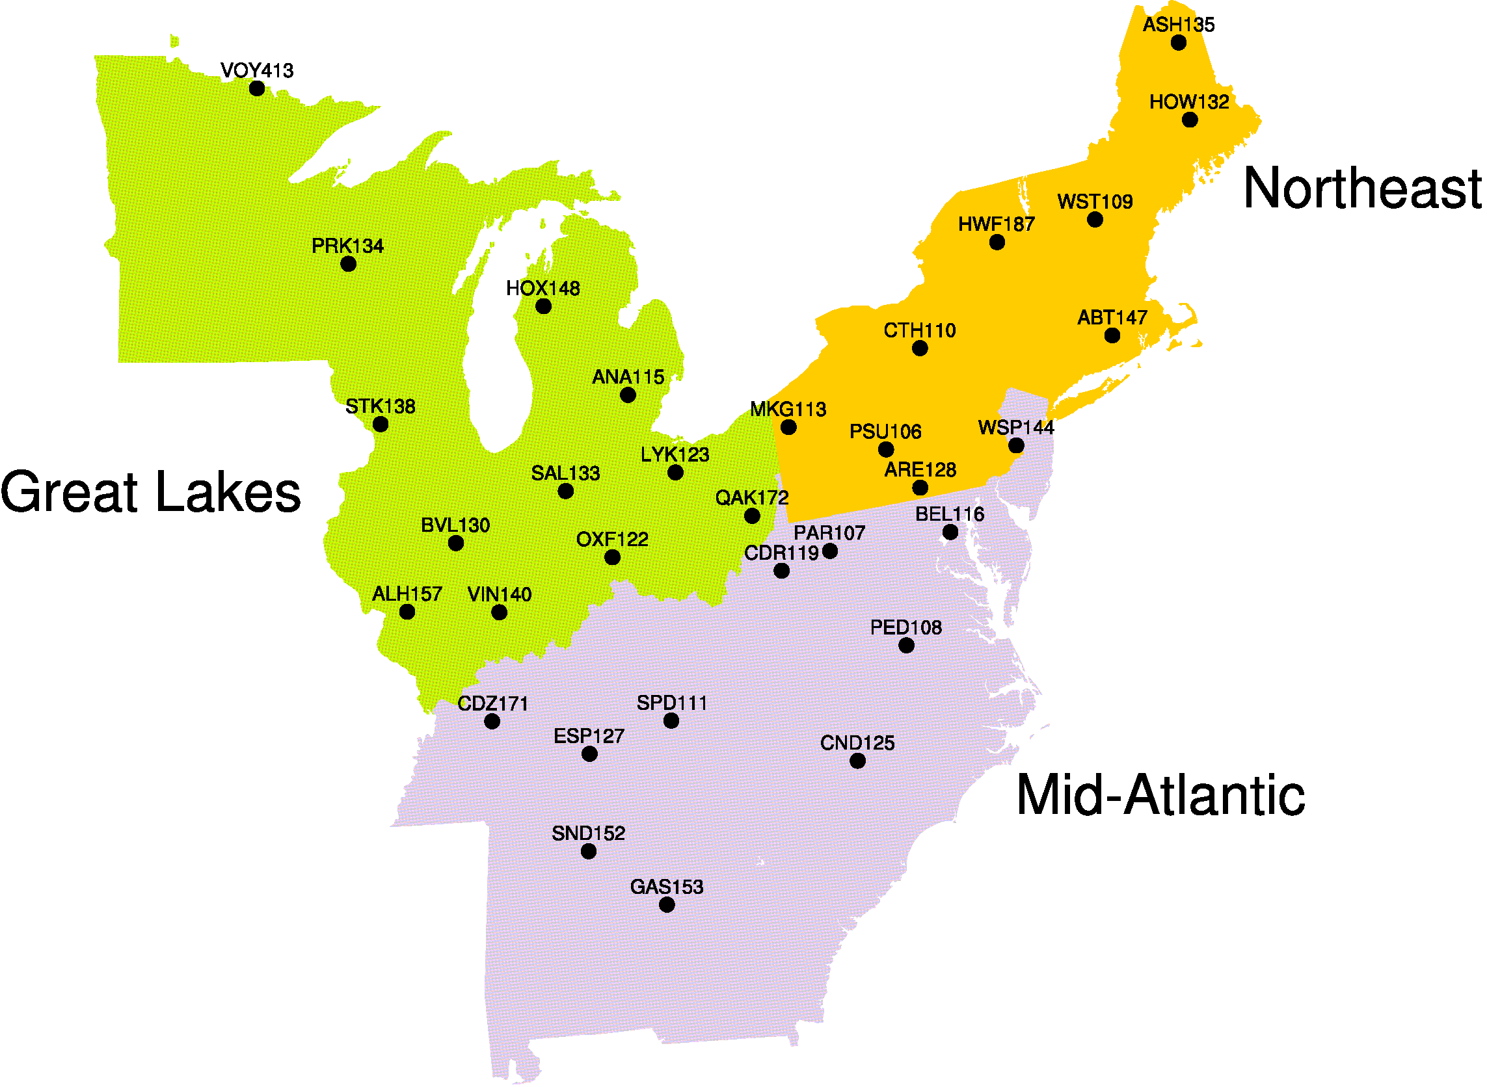
Characterizing regional O₃-temperature relationships
EPA CASTNet sites and locations (1988-2009):
We use:
maximum daily 8-hour average (MDA8) O₃ and maximum daily surface temperature (T_{max}) to focus on the daytime (deep, well-mixed, boundary layer)
Northeast
Regional boundaries motivated by past statistical studies [Bloomer et al., 2009; Eder et al., 1993; Lehman et al., 2004]
Site selection criteria:
all sites are below 600m
50 km from oceanfront
at least 7 years of data
O₃ has been observed to vary approximately linearly with temperature for the range ~290 – 305K
[Bloomer et al., 2009; Camalier et al., 2007; Sillman and Samson, 1995; Steiner et al., 2010]
Notes:
co-located measurements of meteorology and chemistry
22 years of data (1988-2009)
designed for measurements to be representative of the regional scale
We group CASTNet sites into chemically and meteorologically coherent regions

Slide 5
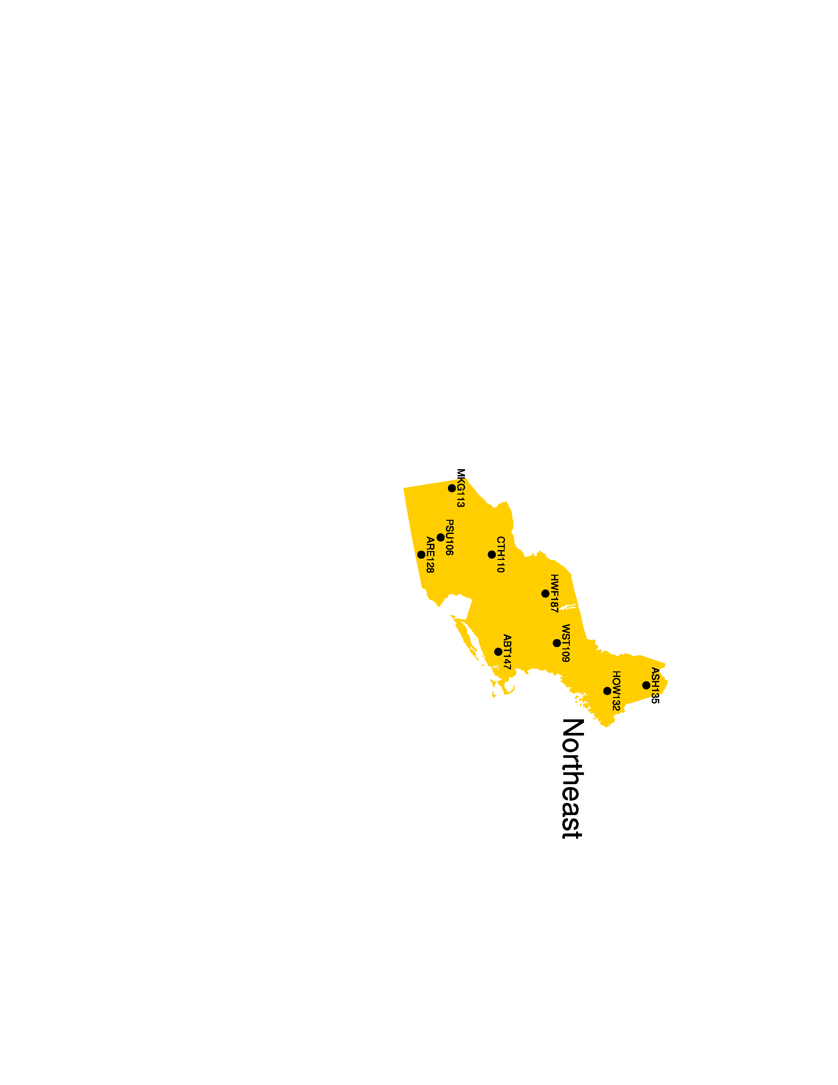
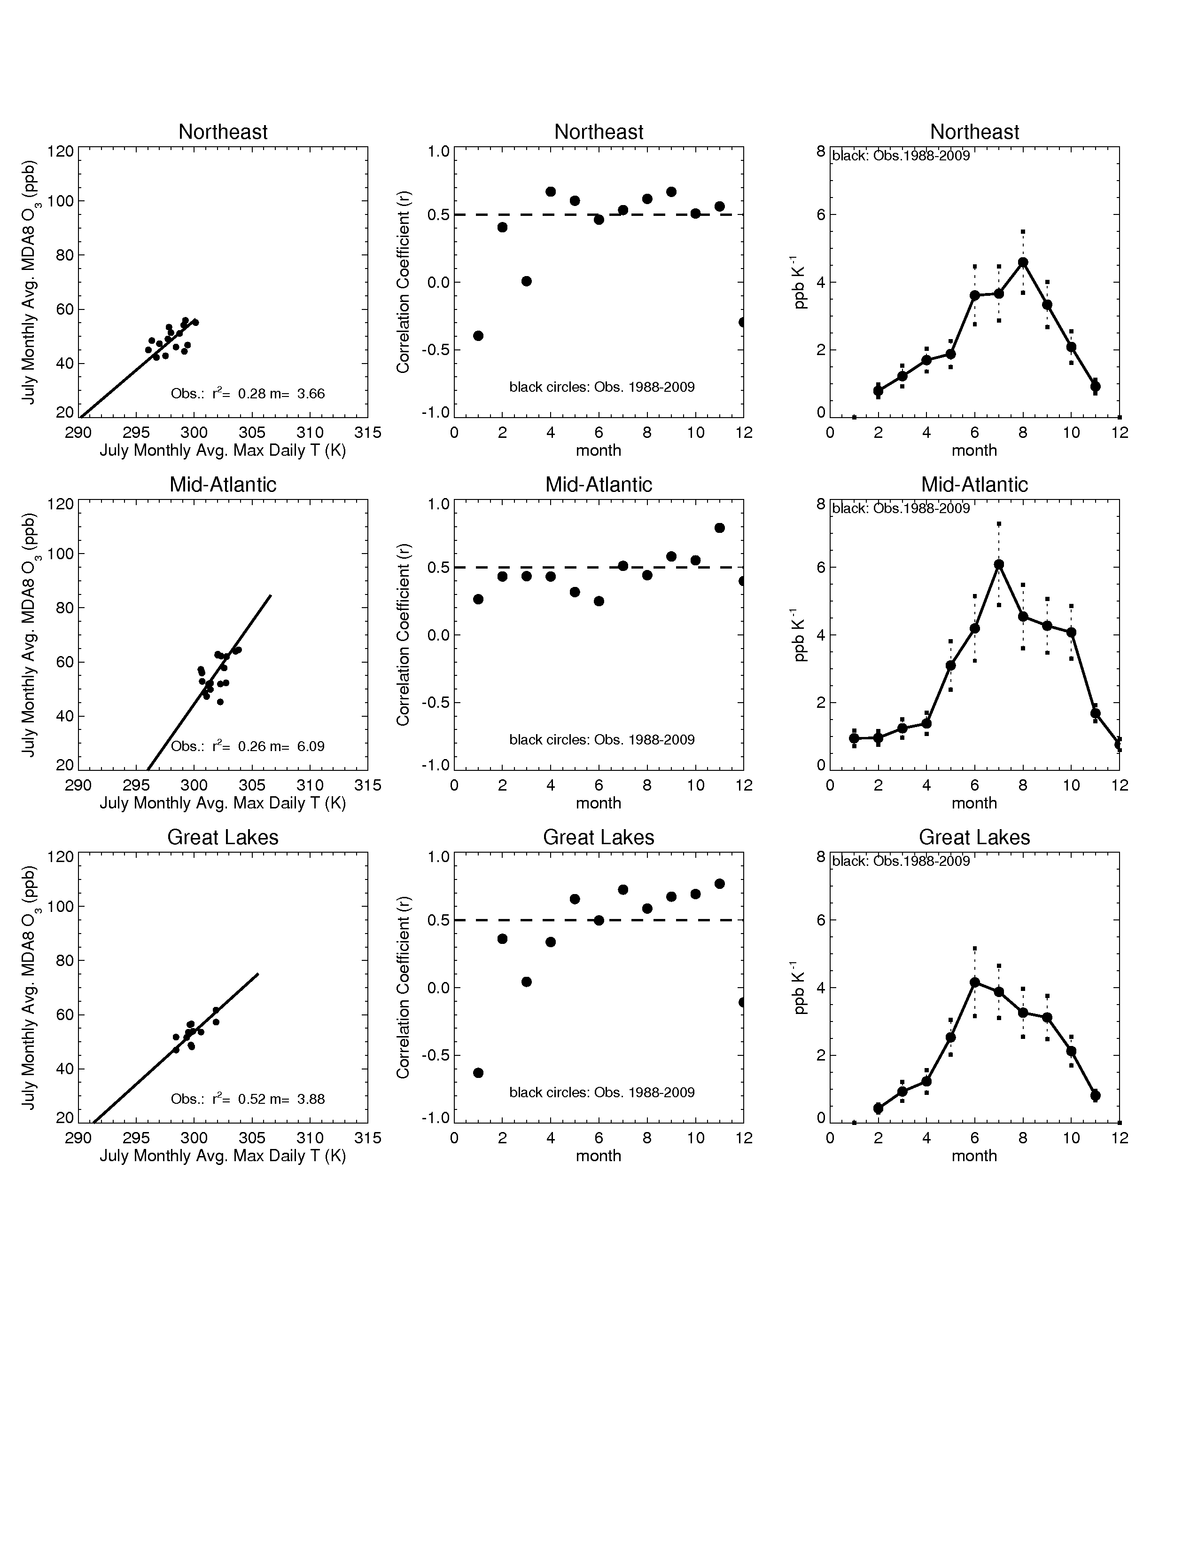
Observed O₃ – T relationships over the Northeast
We average over all CASTNet sites to isolate the regional response of O₃ to temperature
Seasonality of Northeast m_{O3-T}
CASTNet (1988-2009)
Northeast MDA8 O₃ –T_{max} correlation
CASTNet (1988-2009)
= regional avg. of MDA8 O₃ and T_{max}; each point is data from one year
r² = .3 m_{O3-T} = 3.7 ppb K⁻¹
highest O₃ sensitivities to temperature in summer (3-5 ppb K⁻¹)
Notes:
The slope of the O₃-T_{max} relationship has a distinct seasonal cycle (reflecting ∆ met variables) that is reproduced by the model

Slide 6
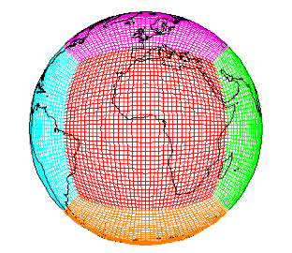
The GFDL AM3 chemistry-climate model
Donner et al., Golaz et al., Griffies et al., J. Climate, 2011
GFDL-AM3
SSTs/SIC from observations
cubed sphere grid
~2°x2°; 48 levels
Forcing
Solar Radiation
Well-mixed Greenhouse Gas Concentrations
Volcanic Emissions
Atmospheric Dynamics & Physics
Radiation, Convection (includes wet deposition of tropospheric species), Clouds, Vertical diffusion, and Gravity wave
Atmospheric Chemistry 86 km
0 km
Ozone–Depleting Substances (ODS)
Chemistry of O_{x}, HO_{y}, NO_{y}, Cly, Br_{y}, and Polar Clouds in the Stratosphere
Chemistry of gaseous species (O₃, CO, NO_{x}, hydrocarbons) and aerosols (sulfate, carbonaceous, mineral dust, sea salt, secondary organic)
Pollutant Emissions (anthropogenic, ships, biomass burning, natural, & aircraft)
MEGAN biogenic emission scheme
Unique full strat & trop chemistry
How well does the model represent observed surface O3-T relationships?
Aerosol-Cloud Interactions
Dry Deposition
Land Model version 3
(soil physics, canopy physics, vegetation dynamics, disturbance and land use)
Naik et al., in prep
Notes:
Coupled atmosphere-oceans-land-sea ice model (CM3) → IPCC AR5 simulations
Vertical levels: surface → 86 km with fully coupled stratospheric-tropospheric-aerosol chemistry
Forced with observed SST and Sea Ice → AM3 → option to nudge to real winds
Additionally implement an interactive isoprene scheme (responds to solar radiation and temperature) (MEGAN) following that used in MOZART-4 [Emmons et al., 2010]

Slide 7
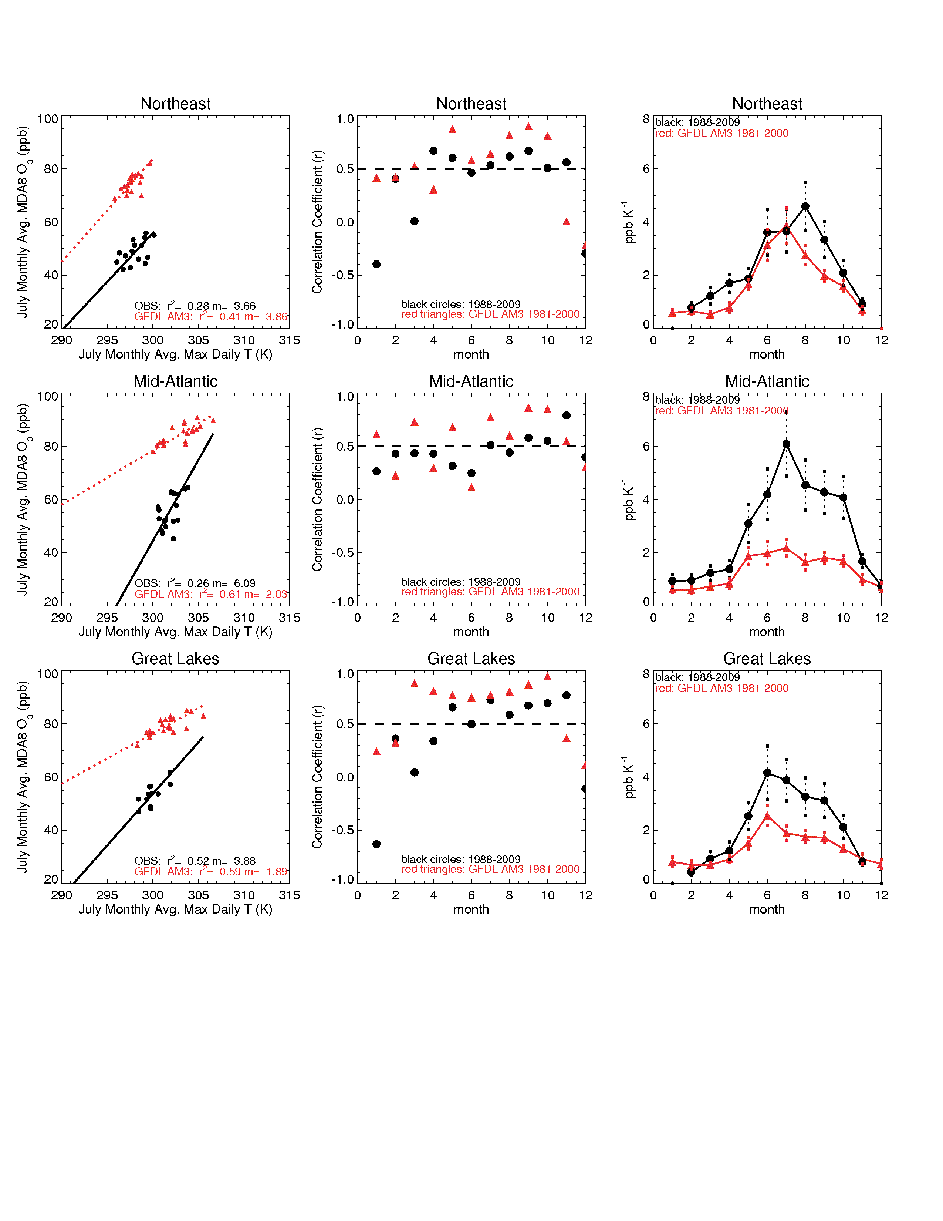
Modeled O₃-T relationships over the Northeast
Northeast MDA8 O₃ –T_{max} correlation
CASTNet (1988-2009)
GFDL AM3 (1981-2000)
T_{max} is well simulated
+15-20 ppb modeled MDA8 O₃ bias
Seasonality of Northeast m_{O3-T}
CASTNet: r² = .3, m = 3.7 ppb K⁻¹
GFDL AM3: r² = .4, m = 3.8 ppb K⁻¹
Despite the presence of excess modeled MDA8 O_{3,} MDA8 O₃ sensitivity to year-to-year variations in T_{max} are reproduced by GFDL AM3 in the Northeast

Slide 8
Modeled O₃-T relationships over the Mid-Atlantic
Mid-Atlantic MDA8 O₃ –T_{max} correlation
CASTNet (1988-2009)
GFDL AM3 (1981-2000)
15-30 ppb modeled O₃ bias
Modeled T_{max} are too large
Seasonality of Mid-Atlantic m_{O3-T}
CASTNet: r² = .3, m = 6 ppb K⁻¹
GFDL AM3: r² = .6, m = 2 ppb K⁻¹
model slopes are ~3-4 ppb K⁻¹ too low in the summer months
What effect does T_{max} bias have on O₃ over the eastern US?

Slide 9
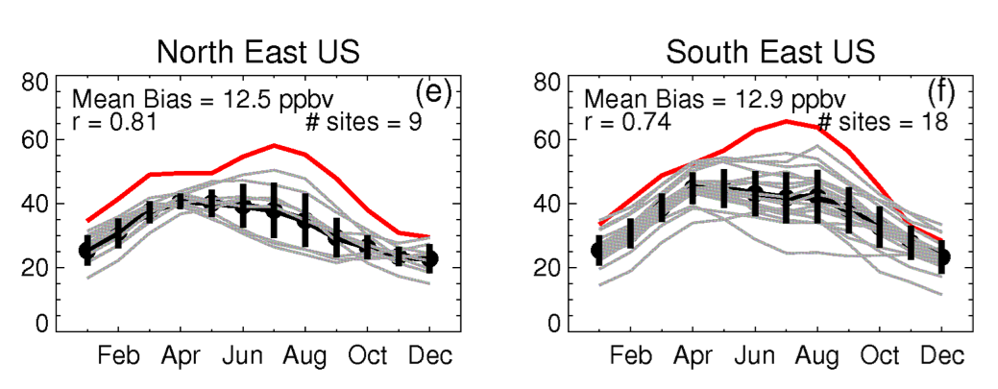
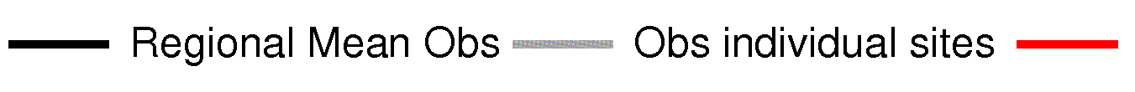
Modeled O₃ bias over eastern US (GFDL AM3)
Modeled O₃ bias is greatest in summertime:
Northeast
Mid-Atlantic
MDA8 O₃ (ppb)
MDA8 O₃ (ppb)
AM3
[c/o V. Naik]
Possible causes of summertime bias:
isoprene chemistry?
deposition to vegetation?
ventilation (convection)?
excessive photolysis?
temperature biases?

Slide 10
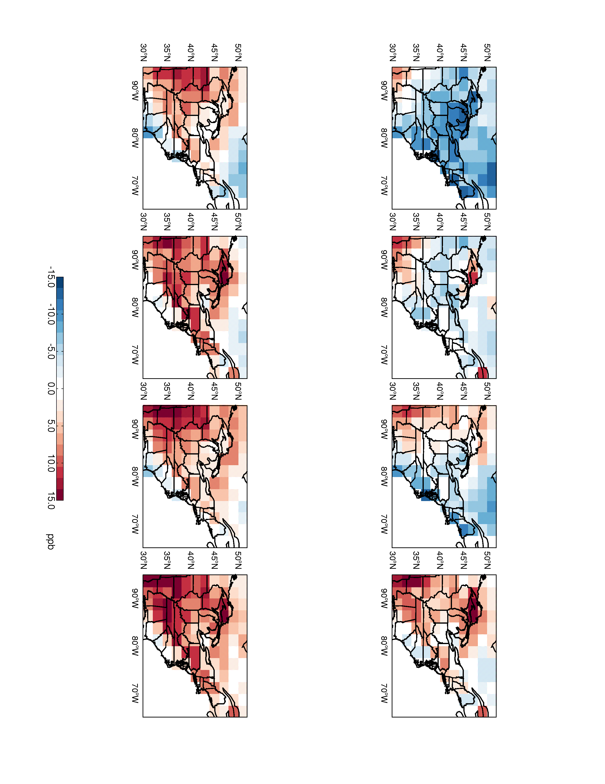
Influence of model Tmax biases on summertime O₃ bias
Multiplying T_{max} biases by mean regional sensitivity of 3 ppb K⁻¹…
JUN JUL AUG SEP
Maurer et al. [2002]
NARR
Rasmussen et al. [in press]
T_{max} biases could be responsible for up to 10-15 ppb of the summer O₃ bias, specifically in the interior of the Mid-Atlantic region
Not the major driver of the large-scale eastern US summertime O₃ bias
Notes:
We find 3 ppb per K to be a conservative estimate of O3 sensitivity to temperature over EUS (including the Great Lakes, not shown)
two independent data sets, the University of Washington (in situ, gridded obs) and the NARR (reanalysis)
Biases in each temperature dataset may influence excess O3 due to temp bias attribution
Note that the UW data set suggests that AM3 is too cool in June, suggesting that modeled O3 is actually under produced!

Slide 11
Conclusions
Despite modeled O₃ biases, the GFDL AM3 reproduces m_{O3-T} in the Northeast, although it underestimates m_{O3-T} by 3–4 ppb K⁻¹ in the summer over the Mid-Atlantic
We estimate a maximum contribution of 10–15 ppb MDA8 O₃ from simulated T_{max} biases over the Mid-Atlantic
We find modeled (+) T_{max} biases are not the major driver of the large-scale excess modeled O₃
Accurate modeled representation of observed O₃-temperature relationships may help to build confidence in future projections of air quality response to changes in climate
See our in press paper online:
Rasmussen, D.J., A.M. Fiore, V. Naik, L.W. Horowitz, S.J. McGinnis, and M.G. Schultz. Surface ozone-temperature relationships in the eastern US: A monthly climatology for evaluating chemistry-climate models. Atmos. Environ., in press

Slide 12
Why is O₃ relevant to climate?
Increasing…
Effect on O₃ concentrations:
Stagnation
Temperature
Wind speed
Mixing depth
Cloud cover
Humidity
=
=
[Jacob and Winner, 2009]
Notes:
Ozone-temperature correlation is primarily based on the association of stagnation with O3 in the eastern US

Slide 13
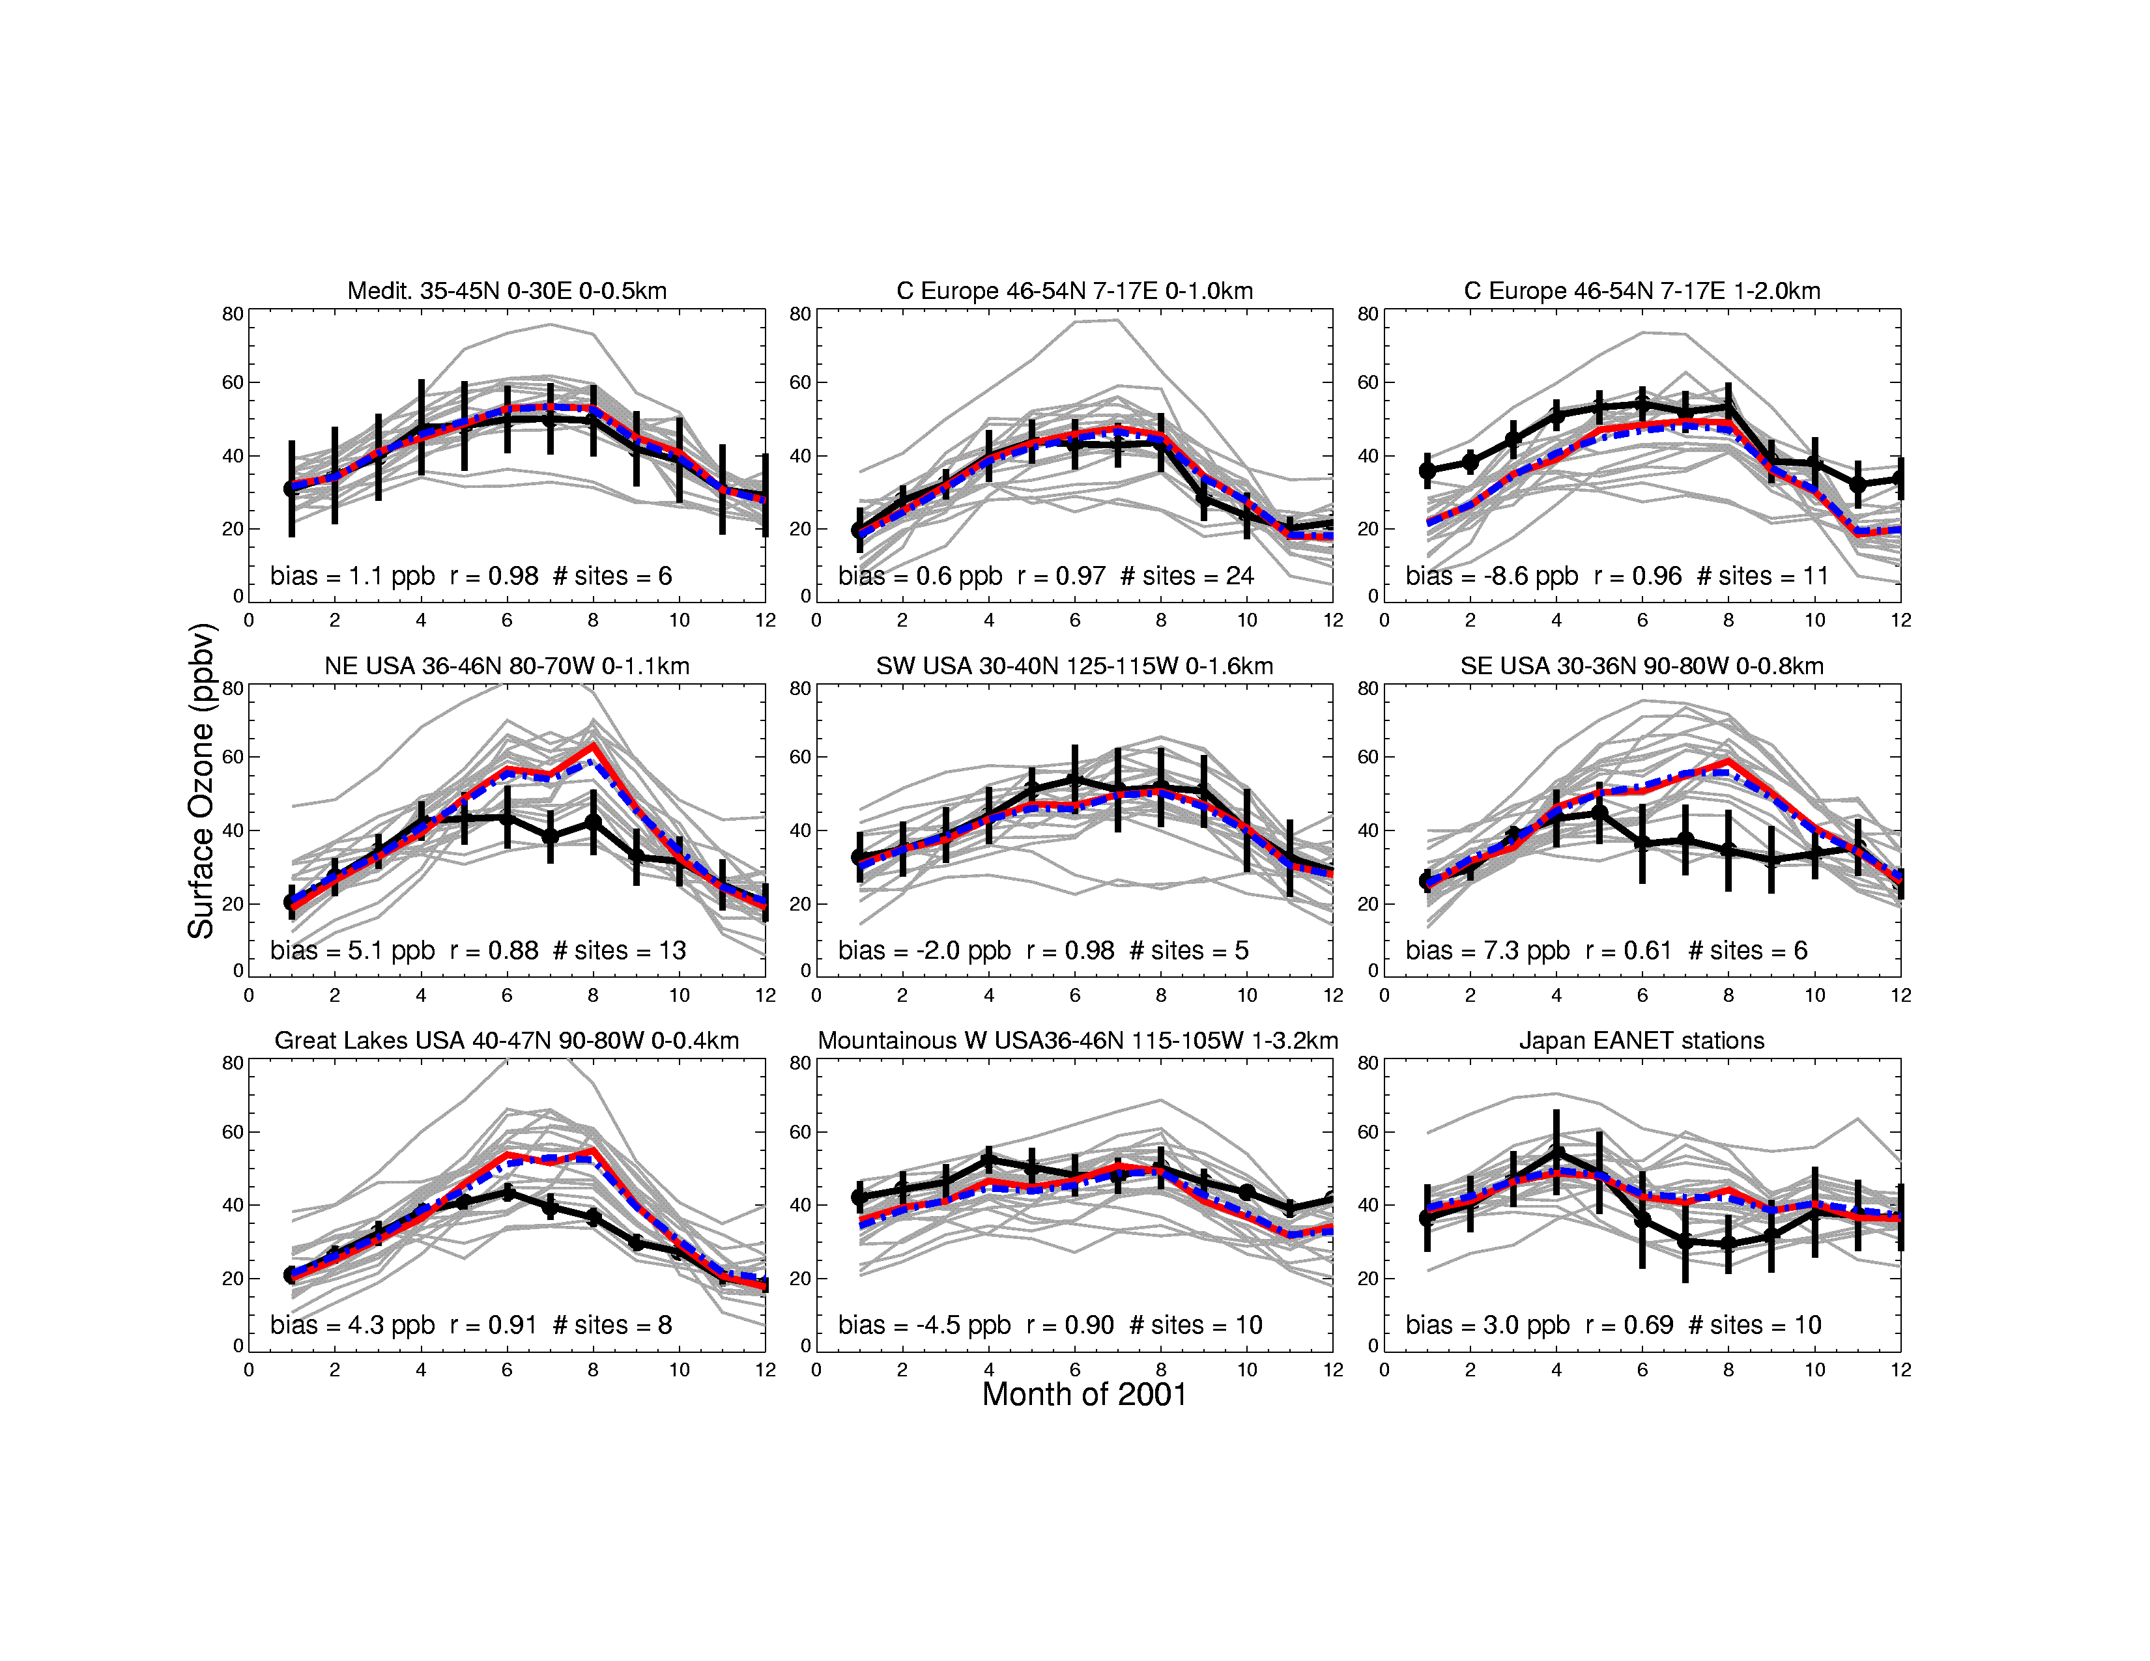
Current generation global models (HTAP)
A pervasive high summertime O₃ bias exists across both eastern US regions [Fiore et al., 2009; Murazaki and Hess, 2006; Reidmiller et al., 2009]
Observations (CASTNet)
Model ensemble mean
Model ensemble median
southeastern US
northeastern US
Surface Ozone (ppb)
Surface Ozone (ppb)
Fiore et al. [2009]
These biases raise concern of the ability of chemistry-climate models to project accurately the response of air pollution to climate change
Notes:
Vertical bars are standard deviations across values from all sites in the region

Slide 14
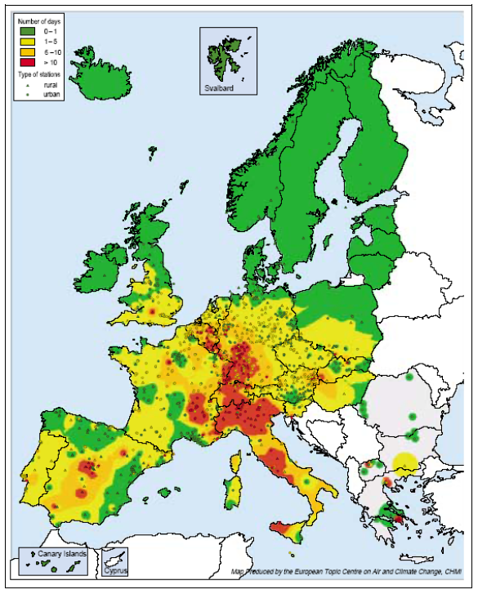
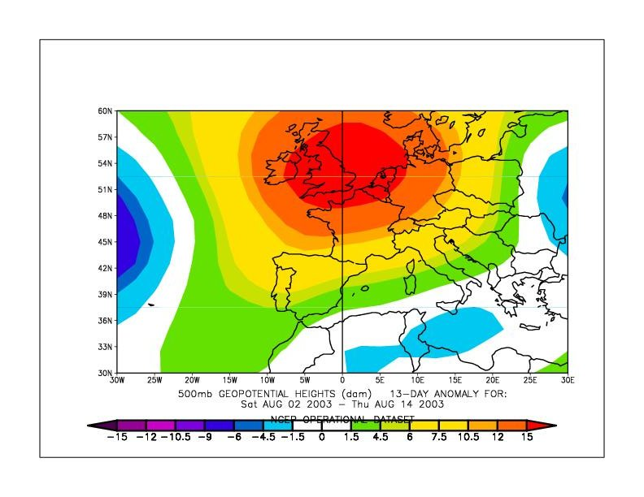
Severe O₃ pollution events associated with air stagnation in Europe
Stagnant high pressure system over Europe
(500 hPa geopotential anomaly relative to 1979-1995 for 2-14 August, NCEP)
8-hr O₃ exceedances of 90 ppb,
summer 2003
# of Days
0-1
1-5
6-10
>10
H
[ETC/ACC, CHMI]
Correlation between surface O₃ and temperature is strongly associated with air stagnation events

Slide 15
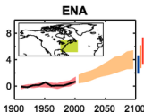
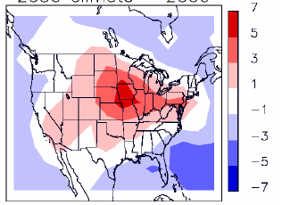
What does a warming planet imply for surface O₃ in the eastern US?
Changes in summer 8-h avg. daily maximum ozone from 2000-2050 climate change
eastern US
Temperature (K)
MDA8 O₃ (ppb)
[IPCC, AR4, Ch. 11]
[Wu et al., 2008]
Higher temperatures, stagnation
Models agree that 2000-2050 climate change will increase surface ozone most over polluted regions (3-5 ppb).
Most models find climate change will exacerbate pollution episodes (up to 10 ppb) due to increased stagnation and higher temperatures.
Models fairly robust in simulating O3 increases in Northeast and Midwest U.S.
Notes:
Orange range envelope is for the A1B scenario over the eastern US
GEOS-CHEM (GISS climate) shown

Slide 16
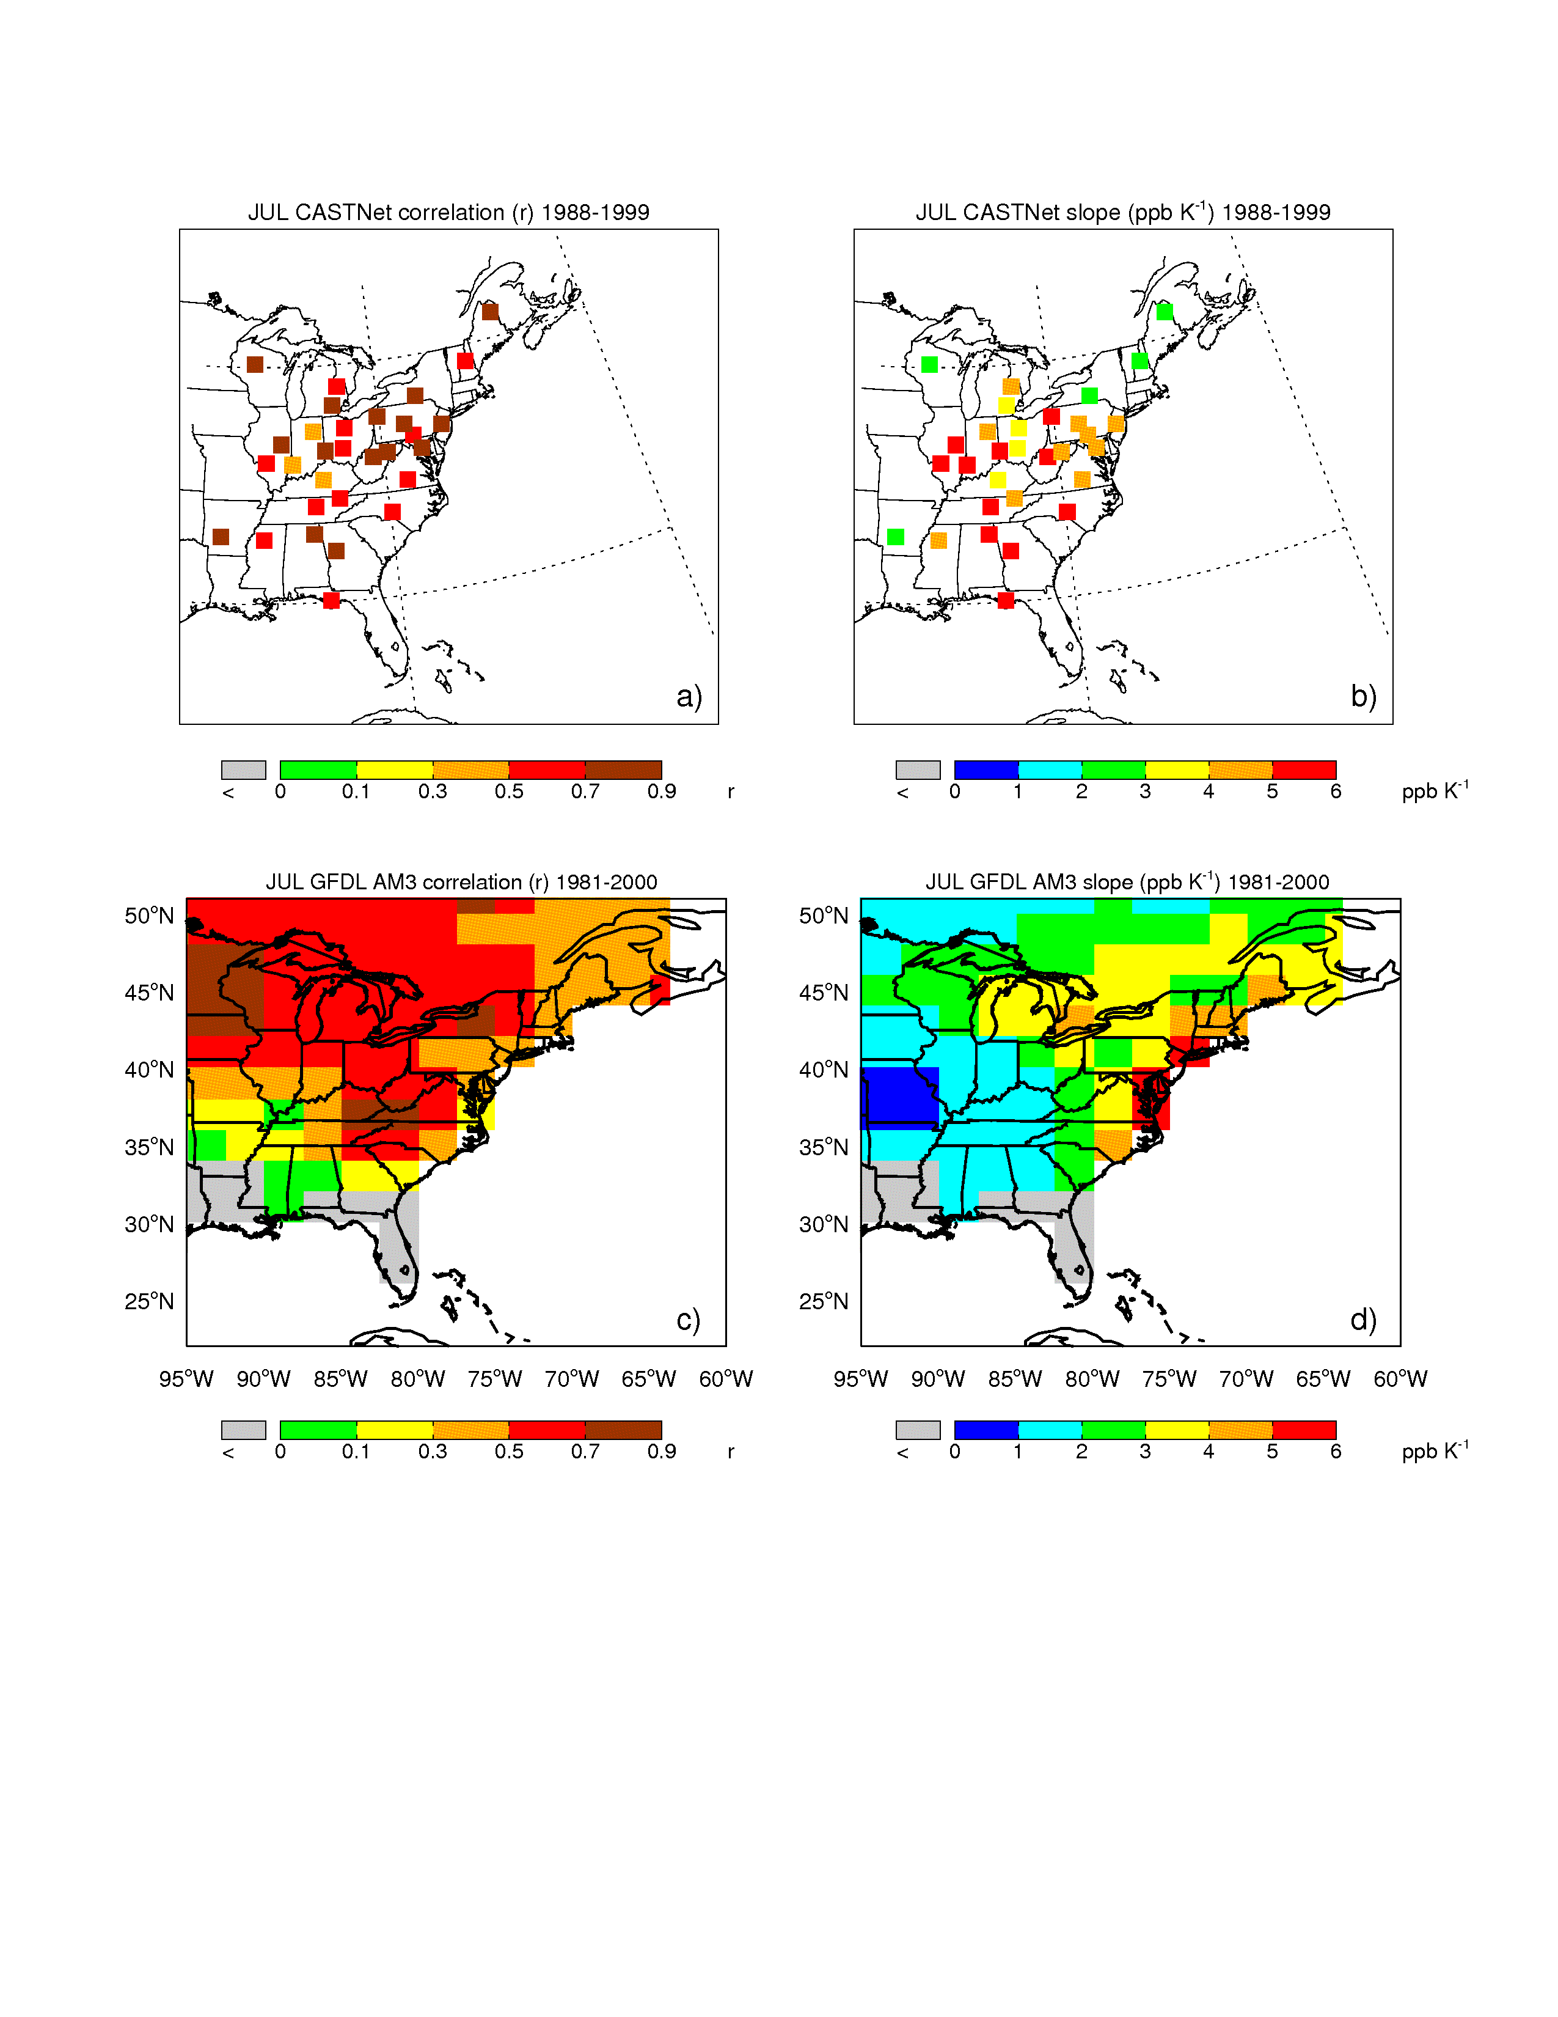
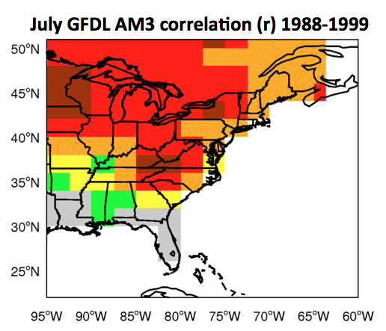
“climatological” O₃-temperature relationships
correlating MDA8 O₃ and daily T_{max}
July CASTNet correlation (r) 1988-1999
July O₃ is well correlated with T_{max}
correlations too low in southern US
-problem representing inflow of marine air, convective ventilation, isoprene chemistry in this region?

Slide 17
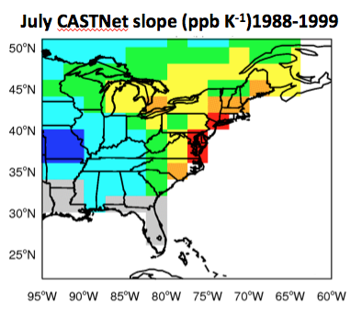
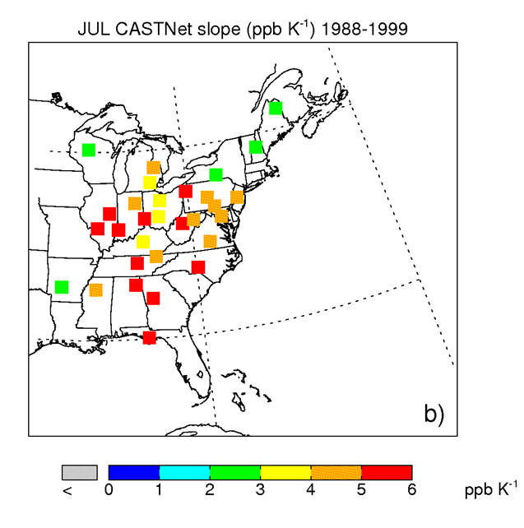
“climatological” O₃-temperature relationships
July CASTNet slope (ppb K⁻¹)1988-1999
July AM3 slope (ppb K⁻¹)1988-1999
m_{O3-T} too low
July m_{O3-T} highest in Mid-Atlantic and southern US
GFDL AM3 produces range of m_{O3-T} over Northeast and portions of the Great Lakes
Remains unclear why GFDL AM3 struggles in Mid-Atlantic and southern US
Notes:
if anyone has ideas, would love to hear them…”

Slide 18
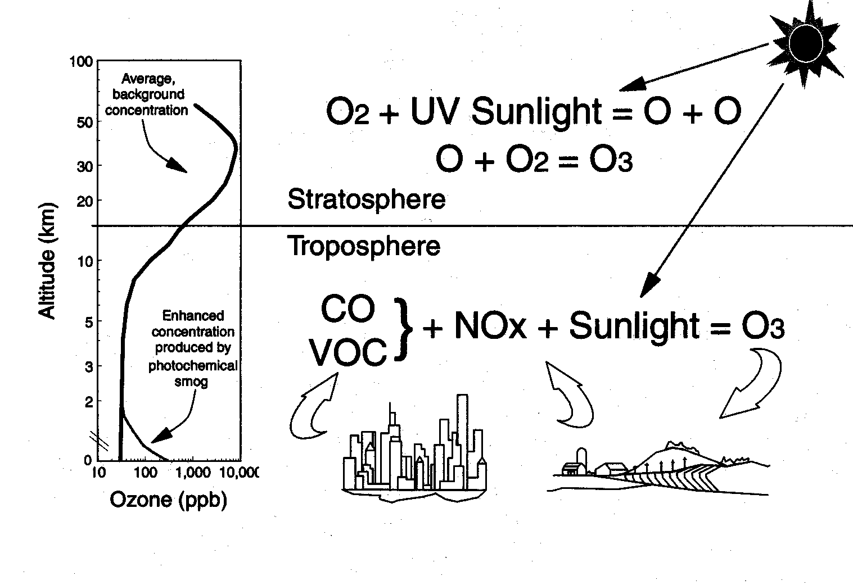
Humans can influence O₃ sensitivity to temperature by changing the O₃ production chemistry
National Ozone Season NO_{x} Emissions from Power Plants
1999 NO_{x} State Implementation Plan (SIP) Call
NO_{x} (million tons/ 5 months)
43% decrease in eastern US NO_{x} emissions!
[c/o US EPA]
Changes to anthropogenic NO_{x} emissions have a substantial effect on the sensitivity of O₃ to temperature

Slide 19
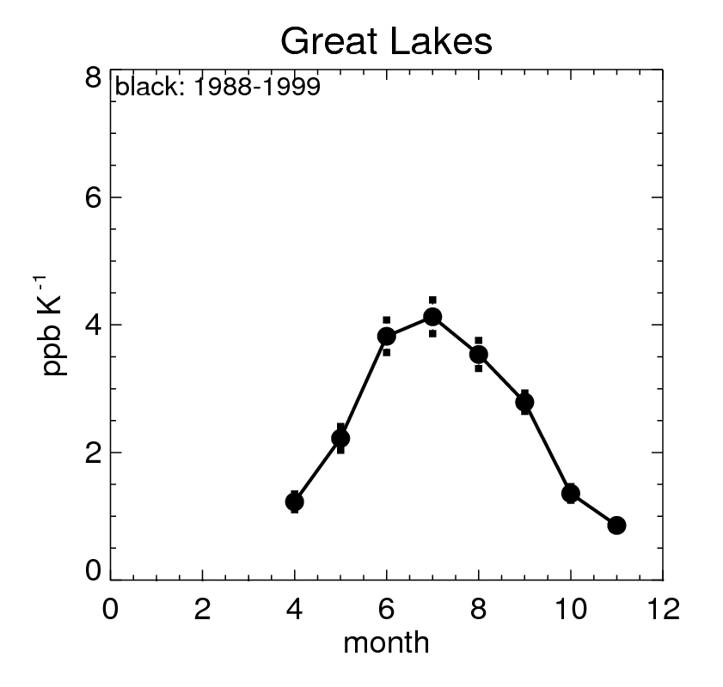
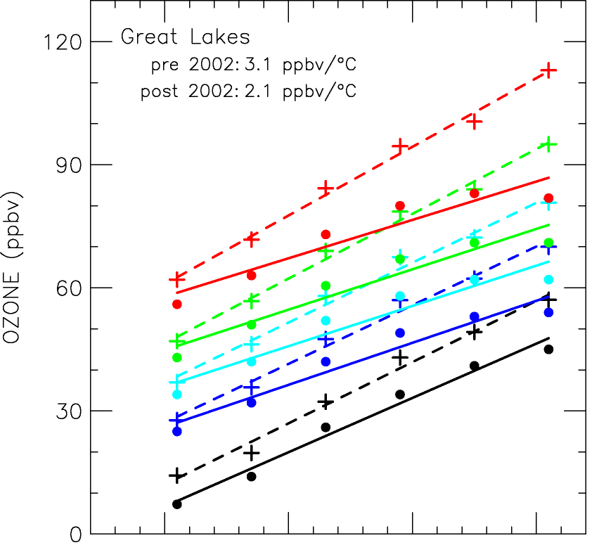
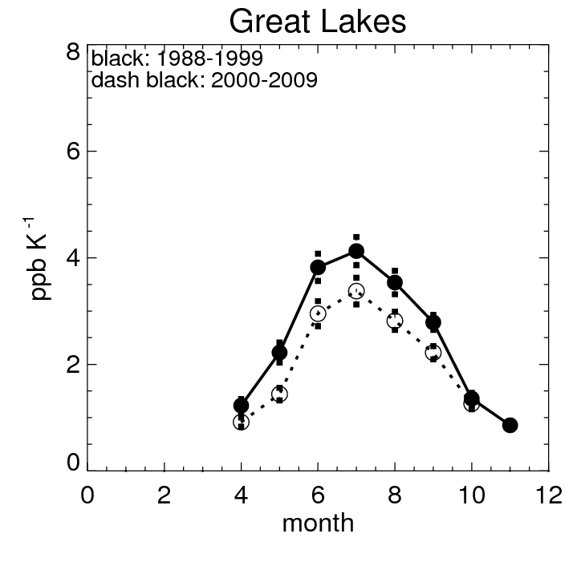
effects of NO_{x} emission controls on O₃ sensitivity to temperature
Great Lakes (May-October)
Great Lakes
Pre 2002: 3.1 ppb K⁻¹
Post 2002: 2.1 ppb K⁻¹
95%
1 ppb K⁻¹ decrease
75%
50%
25%
5%
20 25 30 35
Temperature (C)
[Rasmussen et al., in press]
[Bloomer et al., 2009]
∆ NOx emissions decreased ozone levels over the entire distribution
The ozone sensitivities to temperature also decreased across the distribution
Different statistical methods reveal the same 1 ppb K⁻¹ decrease during O₃ season
Notes:
Rasmussen et al. using data from same observation network, but different groupings, averaging methods, ect.
This regional shift in emissions will complicate our attempts to isolate a long-term

Slide 20
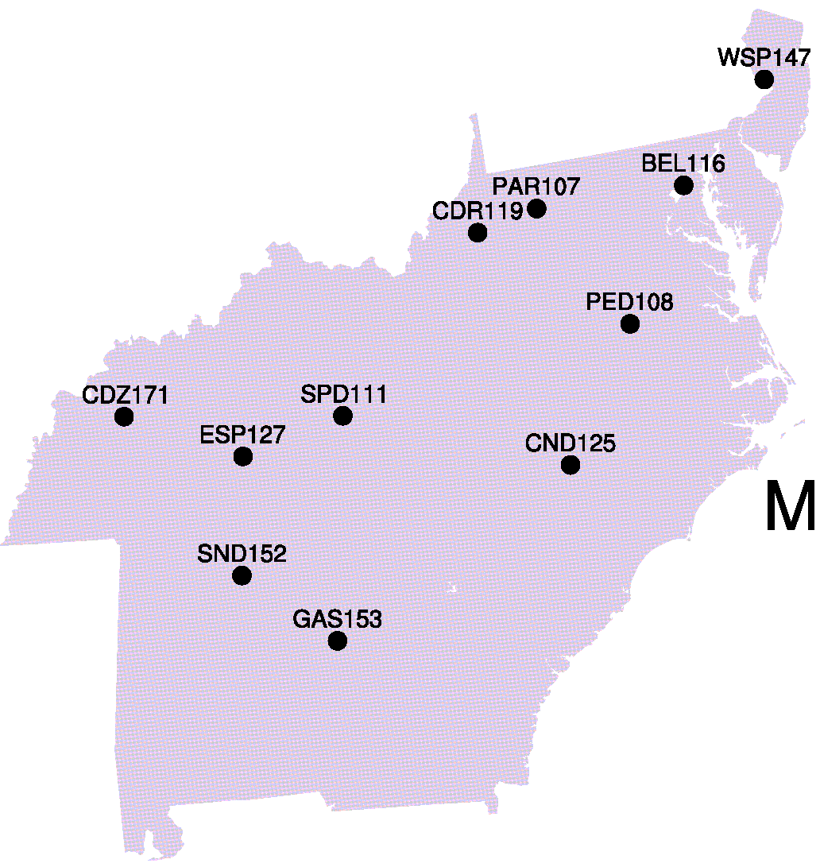
Observed O3 – temperature relationships over the Mid-Atlantic
Highest O₃ sensitivities to temperature are in summer (4-6 ppb K⁻¹)
Seasonality of Mid-Atlantic m_{O3-T}
CASTNet (1988-2009)
Mid-Atlantic MDA8 O₃ –T_{max} correlation
CASTNet (1988-2009)
r² = .26 m_{O3-T} = 6 ppb K⁻¹
Notes:
The model simulates the range of t_{max} in the Northeast, but a ~10 ppb O₃ bias is present
Strong linearity/correlation exists between O3 and tmax during the summer months in both the CASTNet and in the model
The slope of the O₃-T_{max} relationship has a distinct seasonal cycle (reflecting ∆ met variables) that is reproduced by the model

Slide 21
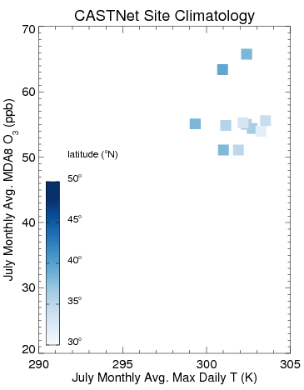
Observed O₃ – temperature relationships over the Northeast

Slide 22
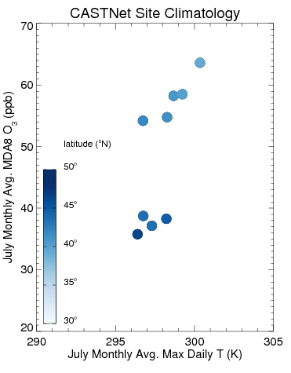
Observed O3 – temperature relationships over the Northeast
CASTNet sites
Notes:
We observe spatial gradients in mean July O₃ and T_{max} exists within region, we attempt to mitigate this by averaging over all sites with in the region

Slide 23
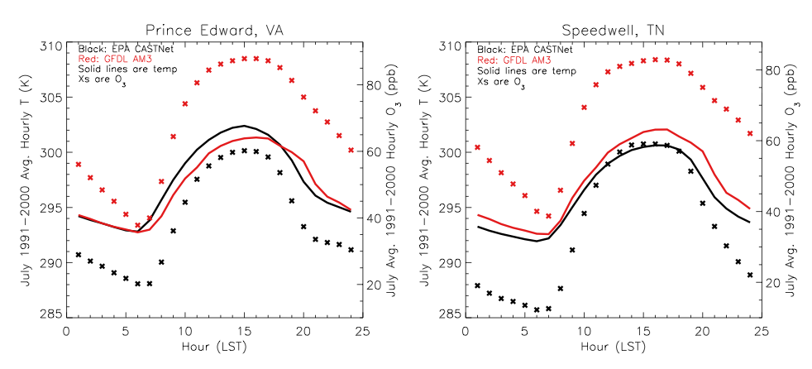
evaluating modeled diurnal temperature and O₃
When diurnal temperature biases are highest, are the O₃ biases correspondingly highest?

Slide 24
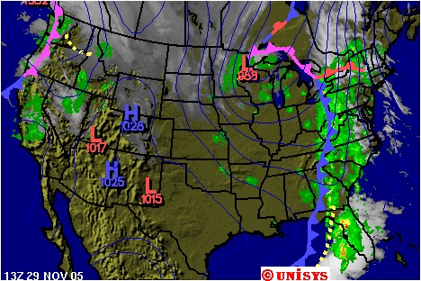
Why does the model struggle in the southeastern US?
Fundamentally different meteorological processes modulate O₃ levels in the southern and northern halves of the eastern US:
cyclonic ventilation of the eastern U.S.
In the Northeast: pollutant ventilation is known to be driven by migratory cyclones associated with cold fronts [Leibensperger et al., 2008; Logan, 1989, Vukovich, 1995]
In the Southeast: Deep convection and inflow from the Gulf of Mexico are known to ventilate O₃ in the boundary layer [Li et al., 2005]
The skill of the GFDL AM3 chemistry-climate model in simulating these meteorological processes may be help explain why O3-temp sensitivities are not accurately produced

Slide 25
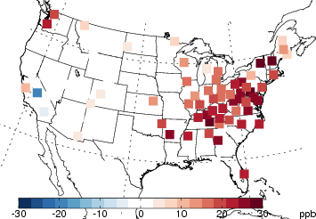
GFDL AM3 CCM eastern U.S. summertime O₃ bias
GFDL AM3 CCM has a high O₃ bias in summer months in the eastern U.S. [10-30 ppb]
June monthly mean MDA8 O₃ Bias (GFDL minus CASTNet)
Notes:
Like many global chemistry models, the

Slide 26
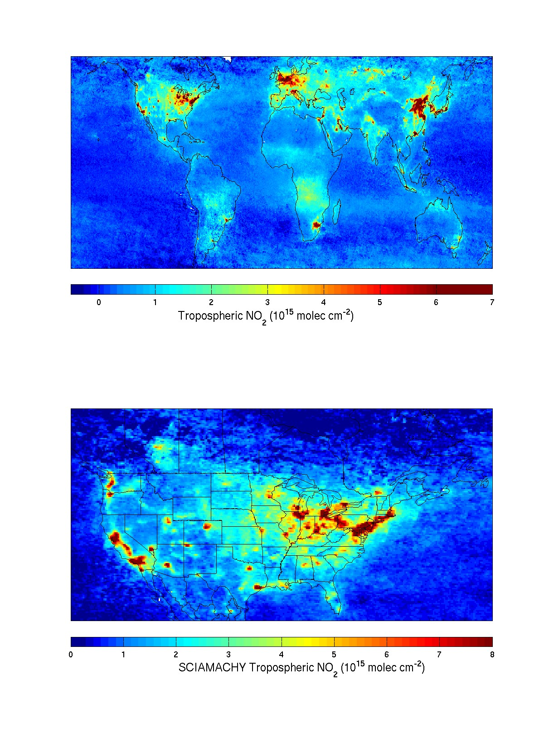
Spatial distribution of NA tropospheric NO₂
SCIAMACHY data. May-Oct 2004
[R.V. Martin, Dalhousie U.]
Notes:
sources: combustion at high temperatures (power plants, vehicles), peroxyacetyl nitrate (PAN)

Slide 27
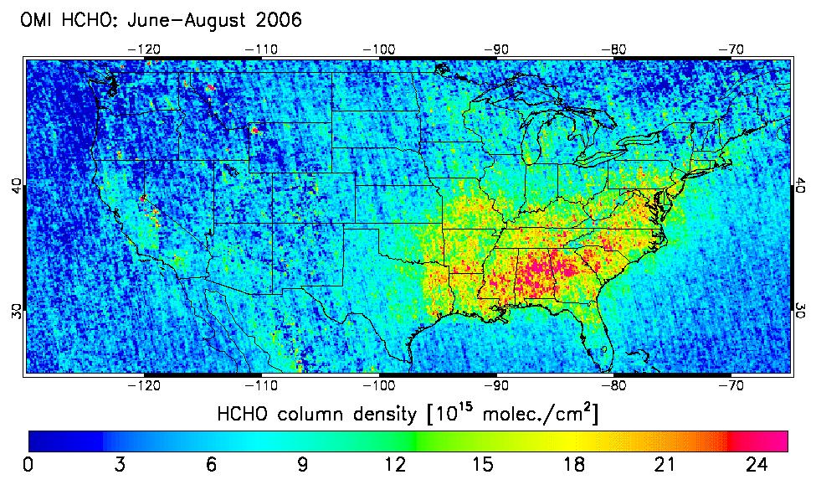
Biogenic VOC (isoprene) column measurements
Millet et al. [2008]
Notes:
Observations taken from satellite instrumentation; isoprene emissions may be means for plants to combat heat stresses

Slide 28
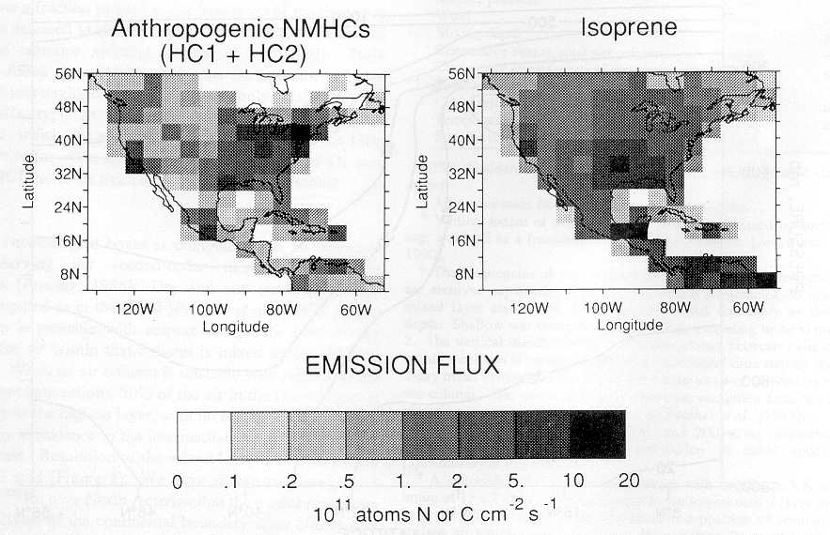
Emissions of VOCs spatially vary
Switches polluted areas in U.S. from NO_{x}-saturated to NO_{x}-limited regime!
recognized in Revised Clean Air Act of 1999
Anthropogenic VOCs
Isoprene (biogenic VOC)
Jacob et al., J. Geophys. Res. [1993]
Notes:
Takeaway point here is that the spatial distribution of emissions (natural and biogenic) greatly spatially vary over the U.S.

Slide 29
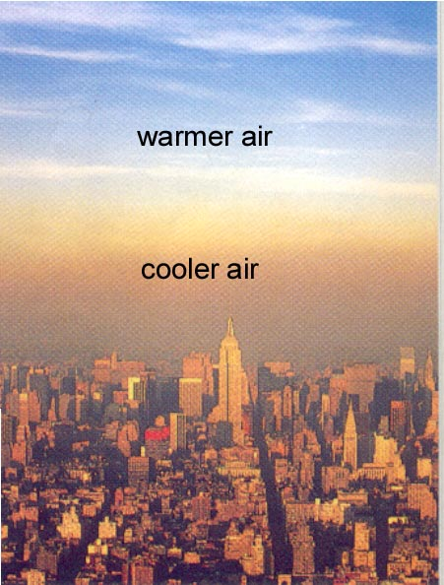
(1) Regional stagnation/ ventilation
Degree of mixing
strong
mixing
Boundary layer depth
pollutant sources
cyclonic ventilation of the eastern U.S.
[Manhattan, NY]
Notes:
Correlation between warm temperatures and stagnant air masses where O3 precursors accumulate and feed local O3 production; or the anti-correlation between NE US cyclones that ventilate polluted boundary layers

Slide 30
Ozone (O₃) in the atmosphere
Good (UV shield) 90% of column O₃ in our atmosphere exists here in the stratosphere
Stratosphere
Troposphere
Bad (Smog) surface O₃ is toxic to both people and plants
Notes:
Strat O3 chemical production/ loss mechanisms are

